Slide 1
Predicting Economic Recessions Using Machine Learning Algorithms by Rickard Nyman and Paul Ormerod
Presented by Ata Kerem Sütçüoğlu

Slide 2
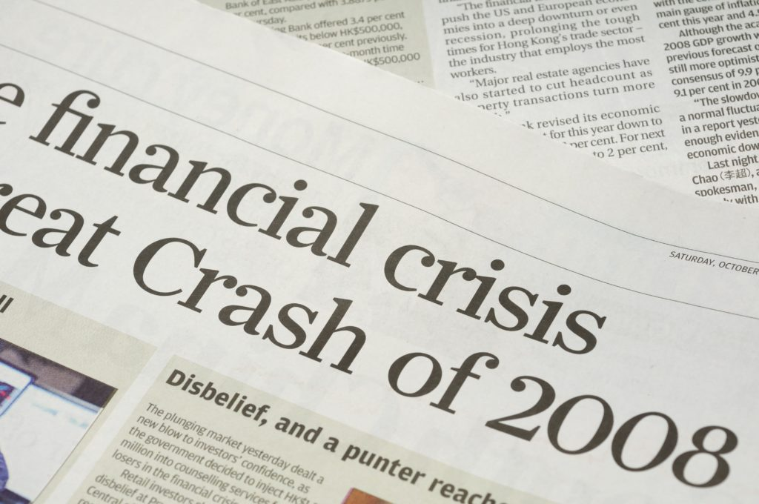
Introduction
A very poor record of predicting recessions.
Failure to forecast the 2008 financial crisis
Question: Can we use machine learning techniques to improve forecasting accuracy?
Focus: Short-term forecasts of real GDP growth in the U.S., also U.K. is included.
Could we predict the recession of the late 2000s?

Slide 3
Data
1970Q2 – 2016Q2 period
Variables are available at the time, and their values are not subsequently revised.

Slide 4
Model Variables
Dependent variable: Third estimate of real GDP growth in the relevant quarter
Generally the one on which policy makers would rely on.
Explanatory variables was selected on a theoretical basis principally from financial markets.
Theoretically the information should exist about the future state of the economy in financial markets.
Explanatory variables used:
3 month T-bill rate
Yield on 10 year U.S. Government Bonds
Quarterly % change in the S&P500 index
Ratio of private sector debt to current price GDP

Slide 5
Tools
Ordinary Least Squares regression
Random forest machine learning
Large number of decision trees with replacement from the observations
Average of the predictions of each tree

Slide 6
Methodology
Regress the GDP growth variable on lagged values of the explanatory variables.
Lags of one to four
Steps:
Regress over the period 1970Q2 through 1990Q1 to predict 1990Q2
Regress over the period 1970Q2 through 1990Q2 to predict 1990Q3
….
Regress over the period 1970Q2 through 2016Q1 to predict 2016Q2
Regress the data series composed of these predictions on the third estimates of GDP growth over the 1990Q2 through 2016Q2 period.

Slide 7
Methodology
Three quarters ahead:
Use the same sample periods
Third through sixth lags of the explanatory variables (t-3, …, t-6)
These values would have been available at the time a three quarter ahead prediction was made.
Same steps with a six quarter ahead prediction, using sixth and seventh lags of the explanatory variables.
Same procedure with the random forest algorithms.

Slide 8
Results for the United States
One step ahead forecasts:
Neither method gave results in terms of explanatory power which are as good as the simple regression of the third estimate of GDP growth on the mean SPF predictions.
Three step ahead forecasts:
SPF track record is very poor over the three quarter horizon
Zero explanatory power over the 1990Q2 – 2016Q2 period.
Linear regression -> R-bar-squared = 0.009
Random forest -> R-bar-squared = 0.149
Six step ahead forecasts:
Linear regression -> R-bar-squared = 0.025 (p-value = 0.059)
Random forest -> R-bar-squared = 0.091 (p-value = 0.001)

Slide 9
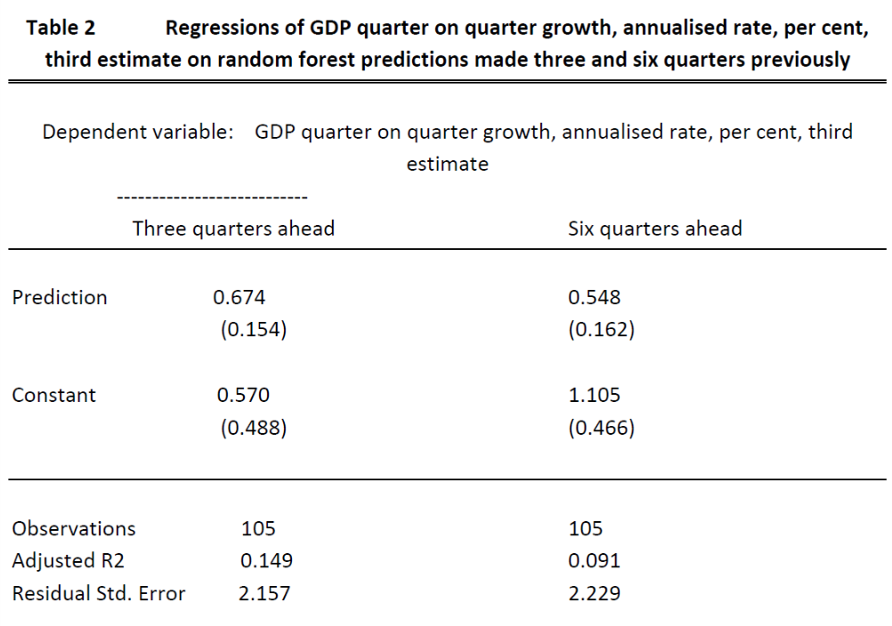

Slide 10
The predictions are in each case biased:
Coefficients on the predictions being significantly different from one
In the case of the six quarter ahead predictions the constant term is significantly different from zero.
However, they each have explanatory power which is significantly different from zero.
In the case of the three quarter ahead, this compares with the zero explanatory power of the mean SPF forecasts

Slide 11
Actual annualized quarter on quarter third estimate US GDP growth, per
cent, and random forest predictions made six quarters previously, 1990Q2 – 2016Q2
solid black line is actual, dotted red line predicted

Slide 12
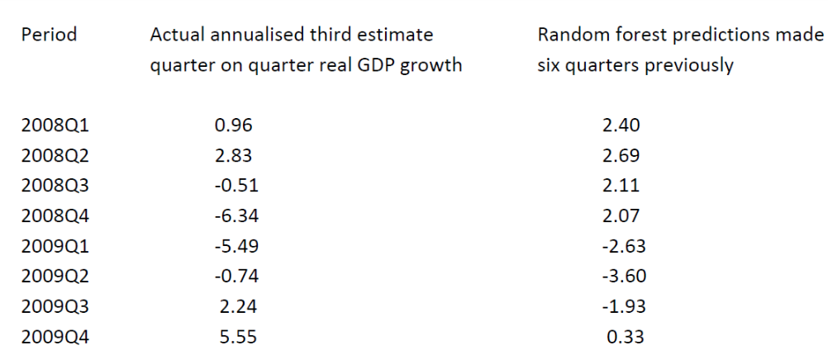

Slide 13
Two other periods of recession in the period on which we focus:
the winter of 1990/91
2001 (technically, there was only one period of negative growth in the third estimate data for 2001, but growth was close to zero in other quarters).
In both cases, the random forest approach predicts six quarters ahead a marked slowdown in growth, but again slightly later than occurred.
.

Slide 14
The approach does not predict a recession, but several periods of growth under 1 per cent.
In general, periods with growth at this low level are associated, for example, with rising unemployment
The random forest does not predict a recession in periods when one did not in fact take place.

Slide 15
United Kingdom case
Explanatory variables:
3 month Treasury Bill rate
Yield on 10 year UK government bonds
Quarterly percentage change in the FTSE All Share Index
Ratio of private sector debt to current price GDP.
Datasource: The Bank of England statistic database
Predict over the period 1995Q1 through 2016Q1, using the Office for National Statistics second estimate of real GDP.

Slide 16
Results for United Kingdom
Three quarters ahead:
Linear regression (using four relevant lags) -> R-bar-squared = 0.004
Random forest -> R-bar-squared = 0.246
Six quarters ahead:
Linear regression (using four relevant lags) -> R-bar-squared = 0.042
Random forest -> R-bar-squared = 0.290

Slide 17
Actual annualized quarter on quarter third estimate UK GDP growth, per
cent, and random forest predictions made six quarters previously, 1995Q2 – 2016Q1
solid black line is actual, dotted red line predicted

Slide 18
Conclusion
In terms of one step ahead predictions of real GDP growth, we have not been able to improve upon the mean forecasts made by the Society of Professional Forecasters.
However, even just three quarters ahead, the SPF track record is very poor.
A regression of actual GDP growth on the mean prediction made three quarters previously has zero explanatory power, and the SPF predictions never indicated a single quarter of negative growth.
The random forest approach improves very considerably on this.
Even more strikingly, over a six period ahead horizon, the random forest approach would have predicted, during the winter of 2007/08, a severe recession in the United States during 2009, ending in 2009Q4.

